Slide 1

Code Refactoring and Bug Fixing

Slide 2
About me
Name : Regina Mary
With a B.E. in Computer Science and a keen interest in Data Science, Machine Learning, Python Development, and Web Development & Designing, I have a strong foundation in both theory and practice. I also part of the Google Developer Student Club at Info Institute of Engineering, where I mentor and guide fellow tech enthusiasts towards mastering cutting-edge technologies and industry-relevant skills

Slide 3
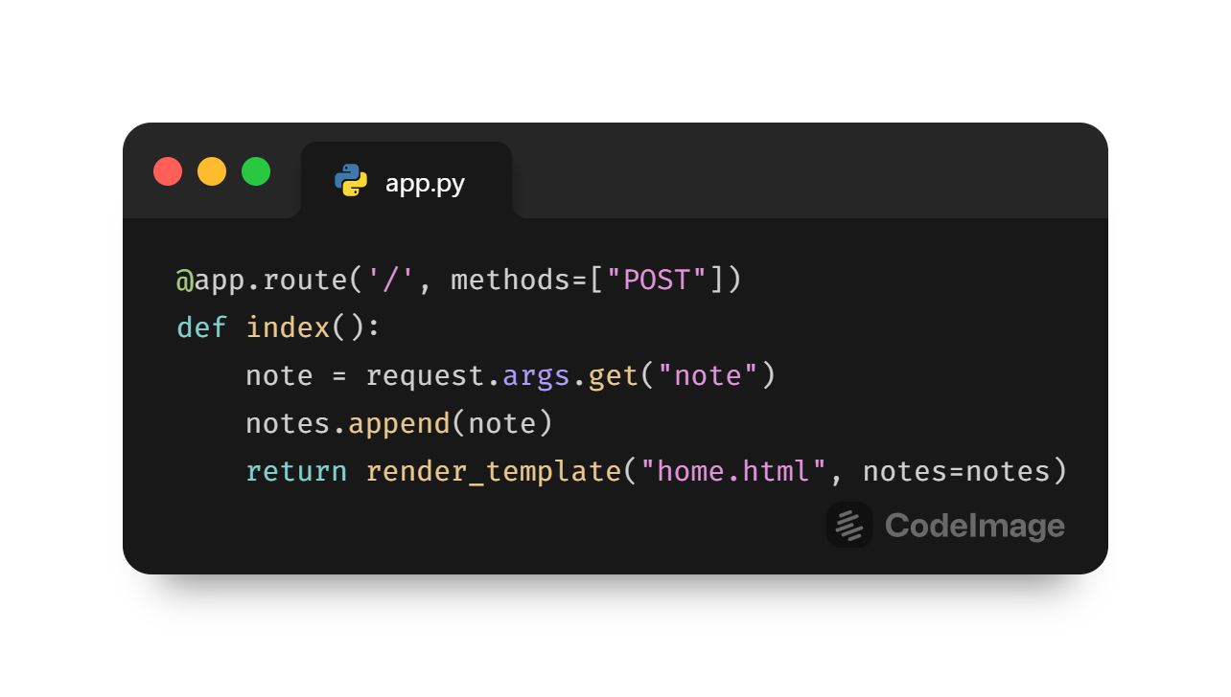
Debugging
The issue in the provided code is that the form in the HTML template is using the GET method to submit data, but the Flask route is only configured to handle POST requests. This mismatch between the form submission method and the route's accepted methods results in a "Method Not Allowed" error when trying to submit the form.
- The Flask route `/` is configured to handle both POST and GET requests using the `methods=["POST", "GET"]` parameter.
- When a POST request is received (i.e., when the form is submitted), the `index()` function retrieves the note from the form using `request.form.get("note")`.
- If a note is provided, it is appended to the `notes` list.
- Then, a redirect to the same route (`index`) is performed using `redirect(url_for('index'))`. This follows the Post/Redirect/Get (PRG) pattern, which prevents form resubmission when the page is refreshed.
- If a GET request is received (i.e., when the page is initially loaded), the `render_template()` function renders the `home.html` template, passing the `notes` list to it for display.

Slide 4
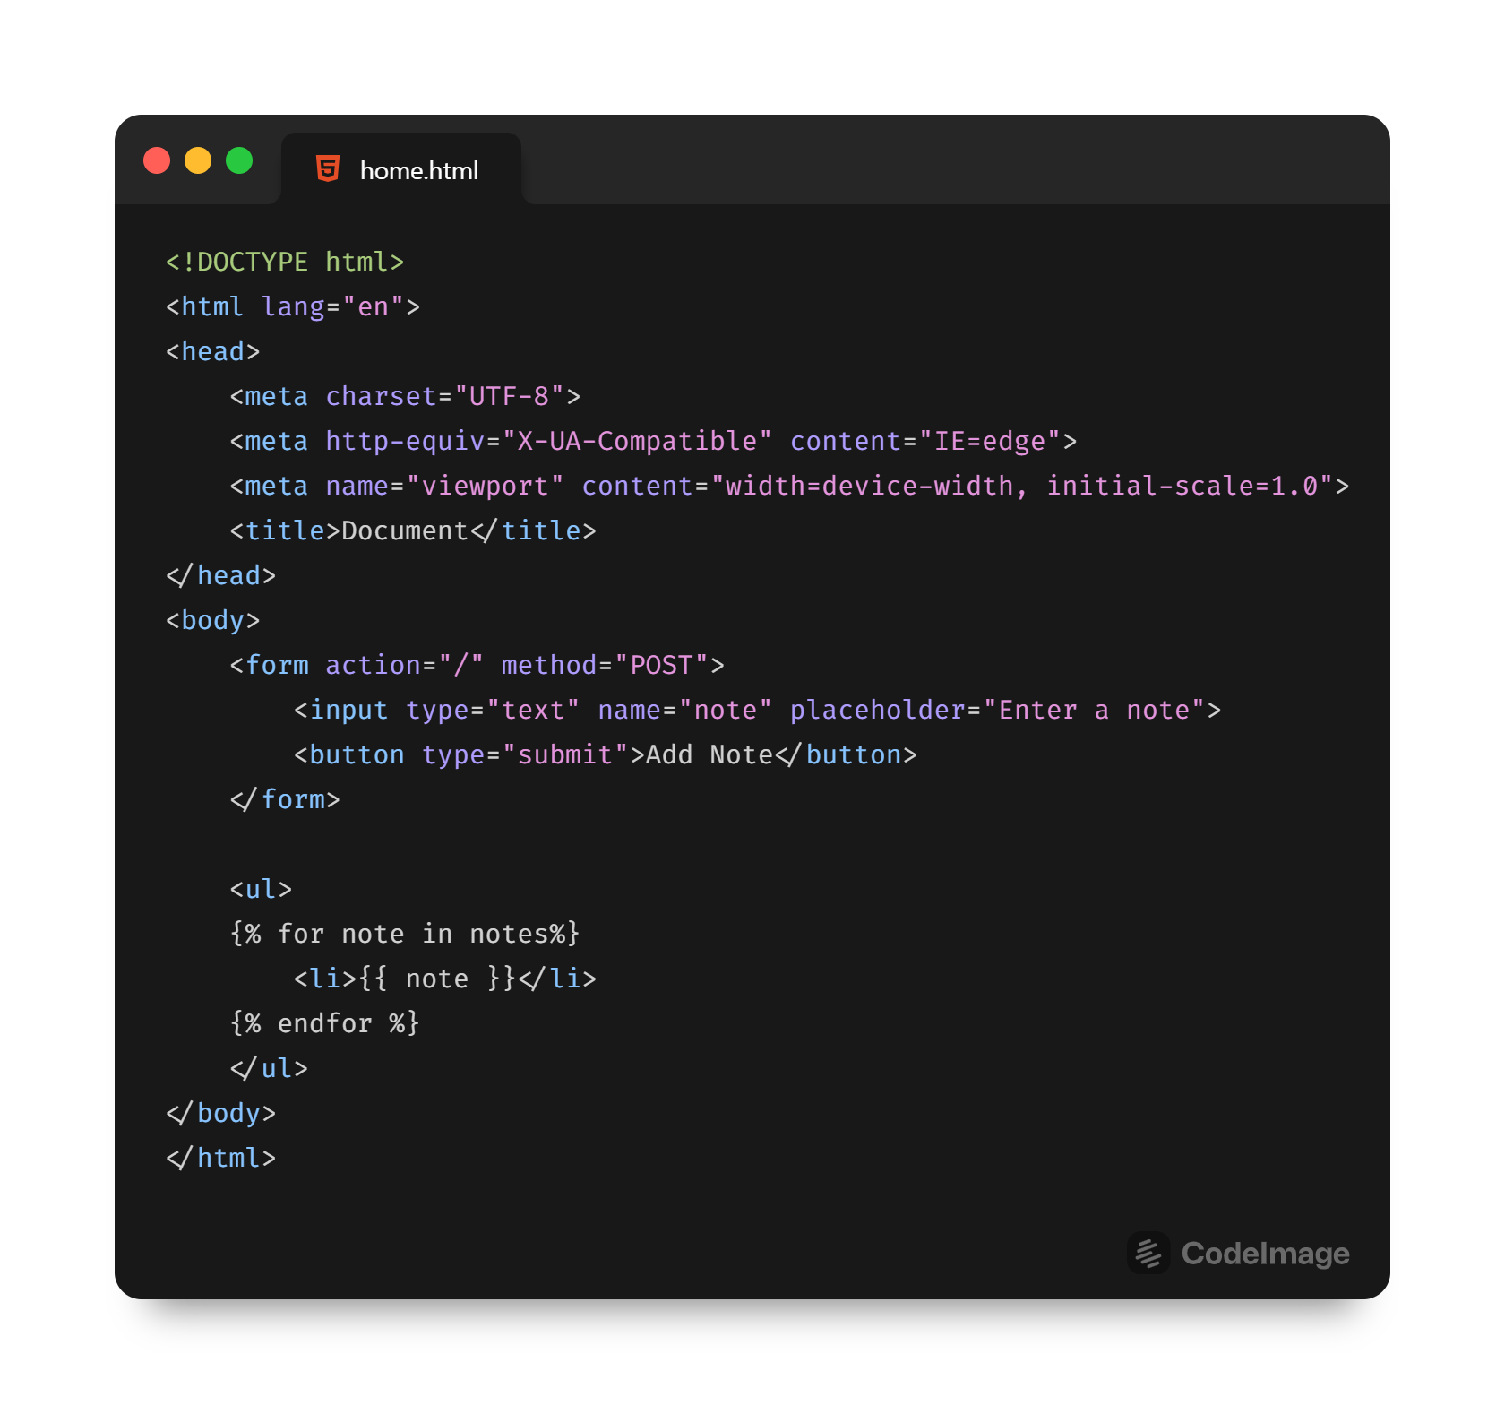
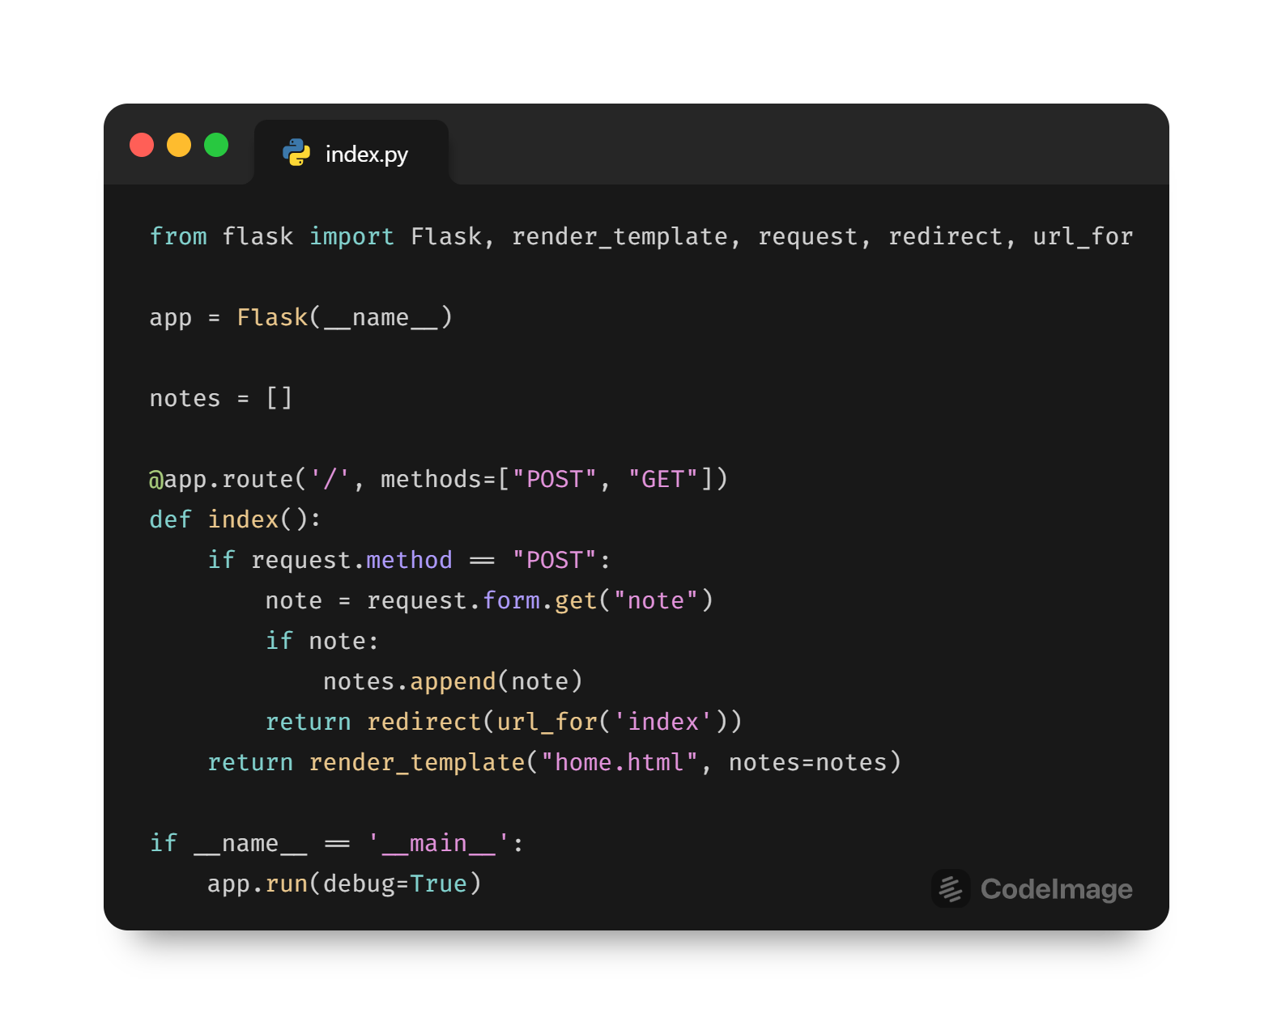

Slide 5

THANK YOU

